Slide 1
CAPSTONE PROJECT
Market Entry Analysis for ABG Motors

Slide 2
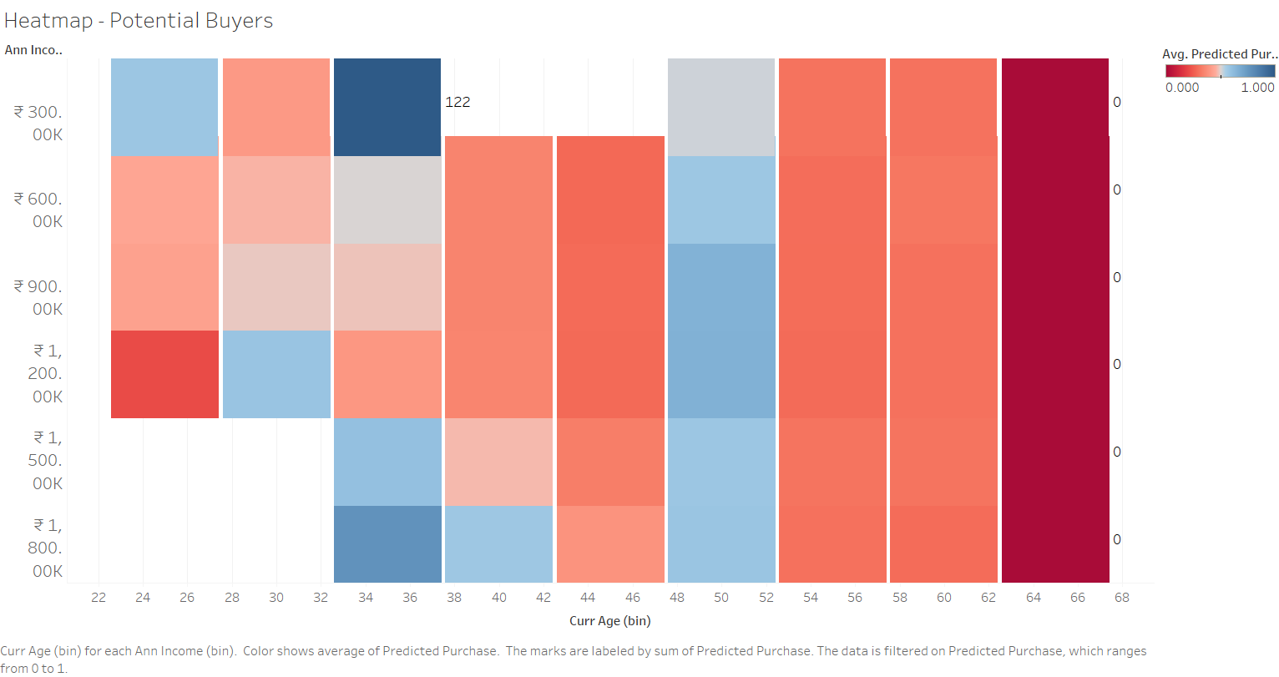

Slide 3
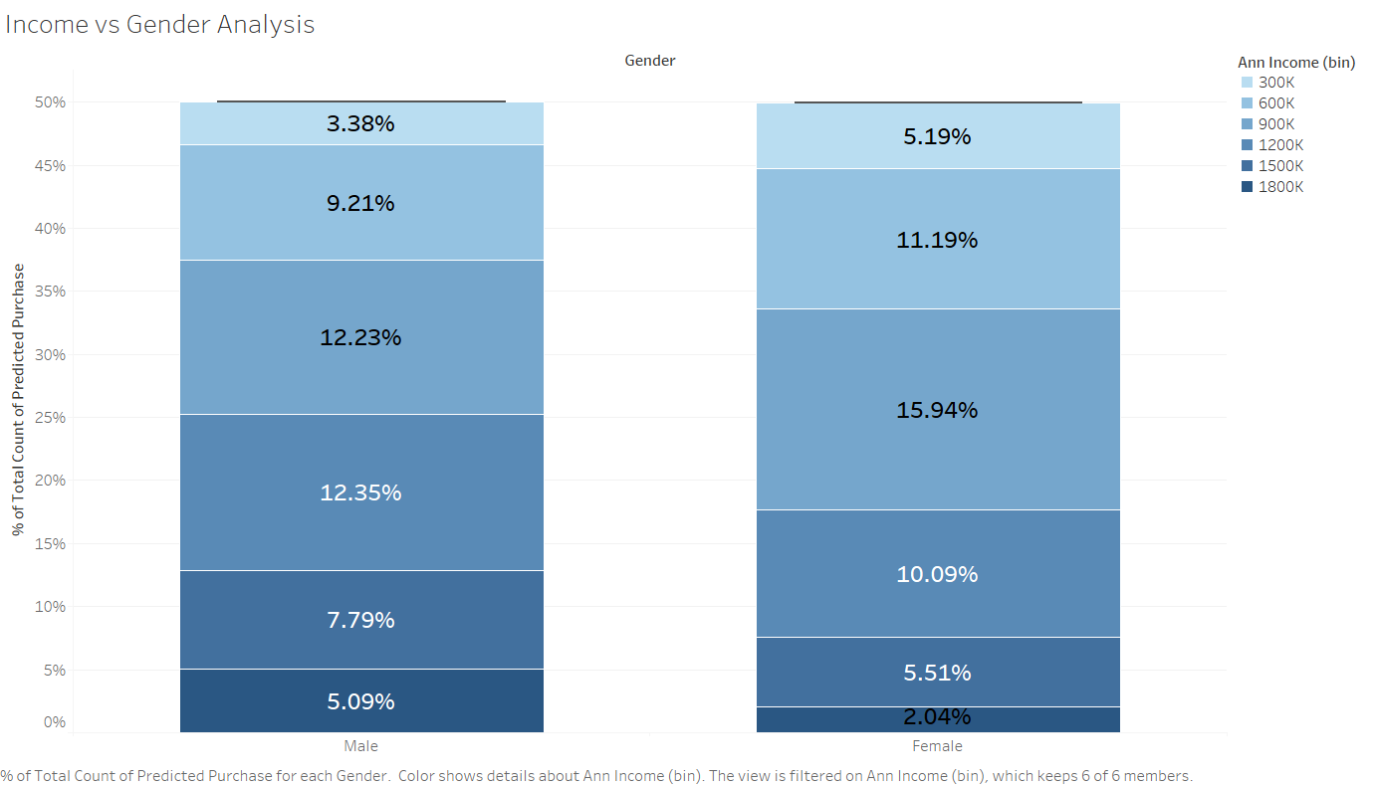

Slide 4
